Slide 1

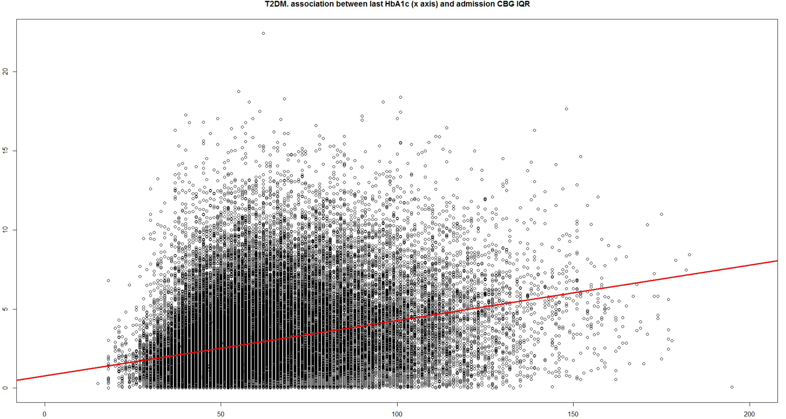
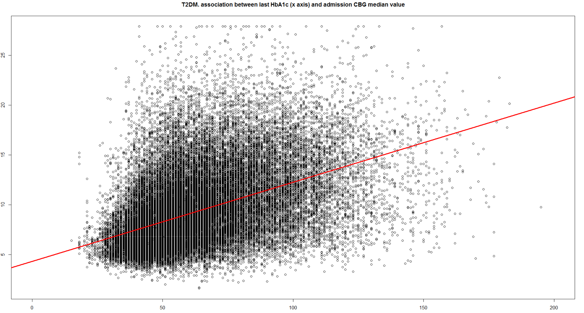
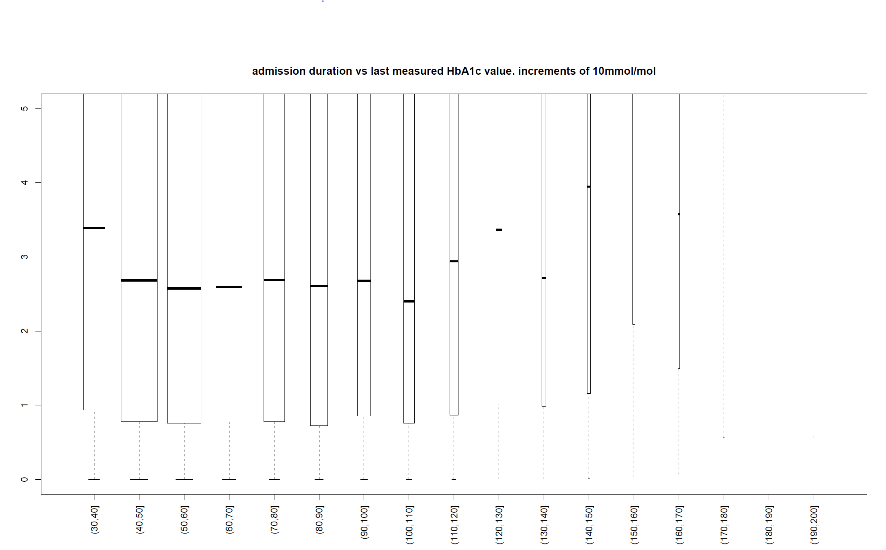
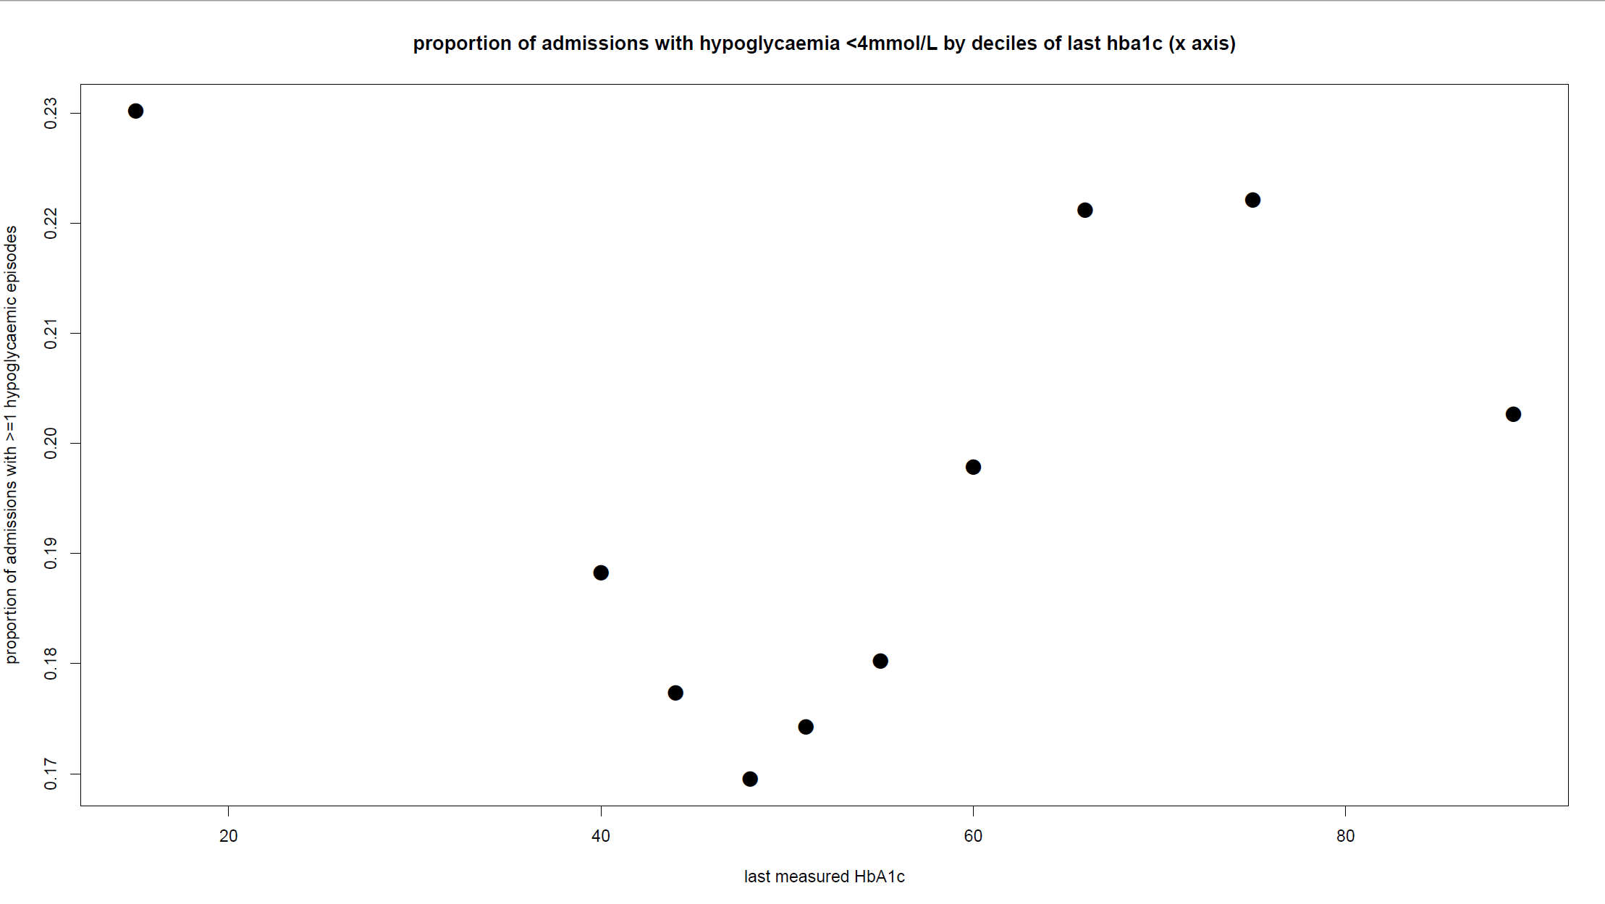
Does pre-admission HbA1c predict inpatient glucose characteristics and outcomes in patients with diabetes?
M Talla¹, SG Cunningham² , CAR Sainsbury¹, GC Jones¹
Department of Diabetes, Gartnavel General Hospital, Glasgow, Scotland
Clinical Technology Centre, Ninewells Hospital, Dundee, Scotland
Introduction
Between 5-10 % of hospital inpatients have diabetes. (1) Diabetes has been unequivocally shown to be associated with both mortality and length of stay (LOS) in hospital in a variety of medical and surgical settings prompting an increasing focus on improving inpatient glycaemic control. (2,3)
HbA1c reflects medium term glucose burden has become an essential measurement in the routine management of diabetes. It is associated with both microvascular and macrovascular complications of diabetes and mortality.
We sought to characterise the association between pre-admission HbA1c and inpatient glucose characteristics.
Methods
We identified all inpatient capillary blood glucose (CBG) readings of patients who appear on national diabetes database (SCI-diabetes) within our health board from 01/2009 to 01/2016. Analysis was performed on admissions with >1 CBGs performed during admission, and where an HbA1c was available within a 15 month widow prior to the date of admission
HbA1c value prior to index admission. median CBG, CBG variability (measured as interquartile range of all CBG values), prevalence of hypoglycaemia during admission, and length of stay (LOS) were analysed per admission.
Results
180786 patient admissions were identified (21426 T1DM, 159360 T2DM)
Pre-admission HbA1c is significantly positively correlated with median CBG (p<0.001) and CBG variability (p<0.001). (Fig 1)
A J-shape association between the last HbA1c and LOS was identified. Minimum LOS was associated with an HbA1c value of 60-70mmol/mol in patients with T1DM and an HbA1c value of 50-60mmol/mol in patients with T2DM. (Fig 2)
In the 159360 patient with T2DM who were admitted a U-shape association between last HbA1c and percentage prevalence of hypoglycaemia (CBG <4mmol/mol) was observed.
The lowest prevalence of hypoglycaemia (17%) was seen in those with HbA1c between 48-51mmol/mol. A significantly higher prevalence of 23% and 22% respectivly was seen in those patients with HbA1c <40mmol/mol (p<0.001) and in those with HbA1c >75mmol/mol (p<0.001). (Fig 3)
Fig 1
Fig 3
Fig 2
Fig 3
Conclusions
Pre-admission HbA1c is positively associated with median CBG levels and glycaemic variability but values at the extremes of HbA1c are associated with the adverse outcomes of hypoglycaemia and longer length of stay. Patients with lower median CBG would likely have been more prone to hypoglycaemia for any given variability whilst those with higher median CBG but higher variability may also have experienced excursions into the hypoglycaemic range. Knowledge of prior HbA1c may be useful stratifying patients on admission for their risk of adverse outcome. If patients who may have high risk of hypoglycaemia and longer LOS can be identified early this may allow proactive intervention by the specialist diabetes team.
References
(1) Trends in recorded capillary blood glucose and hypoglycaemia in hospitalised patients with diabetes. 2014. GC Jones, H Casey, CG Perry, B Kennon, CAR Sainsbury. Diabetes research and clinical practice 104 (1), 79-83
(2) Timmons, Joseph G., Scott G. Cunningham, Christopher A. R. Sainsbury, and Gregory C. Jones. 2016. “Inpatient Glycemic Variability and Long-Term Mortality in Hospitalized Patients with Type 2 Diabetes.” Journal of Diabetes and Its Complications, June. doi:10.1016/j.jdiacomp.2016.06.013
(3) Evans NR, Dhatariya KK. Assessing the relationship between admission glucose levels, subsequent length of hospital stay, readmission and mortality. Clinical Medicine 2012; 12: 137-139.

